Slide 1
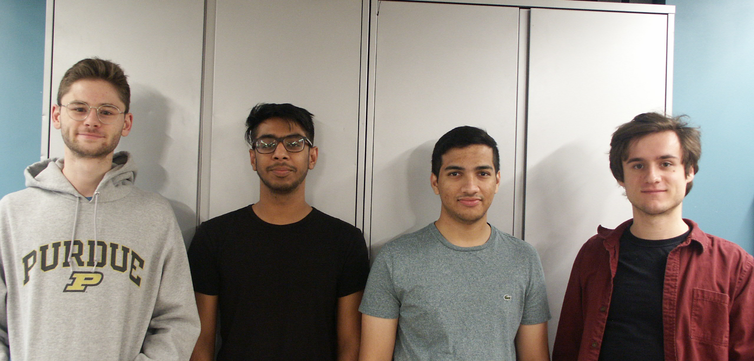
ECE477 Midterm Design Review: Team 8
Notes:
Introduce names.

Slide 2
Outline
Project Overview
Major Components
Block Diagram
Packaging Design
Electrical Schematic
PCB Layout
Prototyping Progress
Software Development Status
Project Timeline
Questions

Slide 3
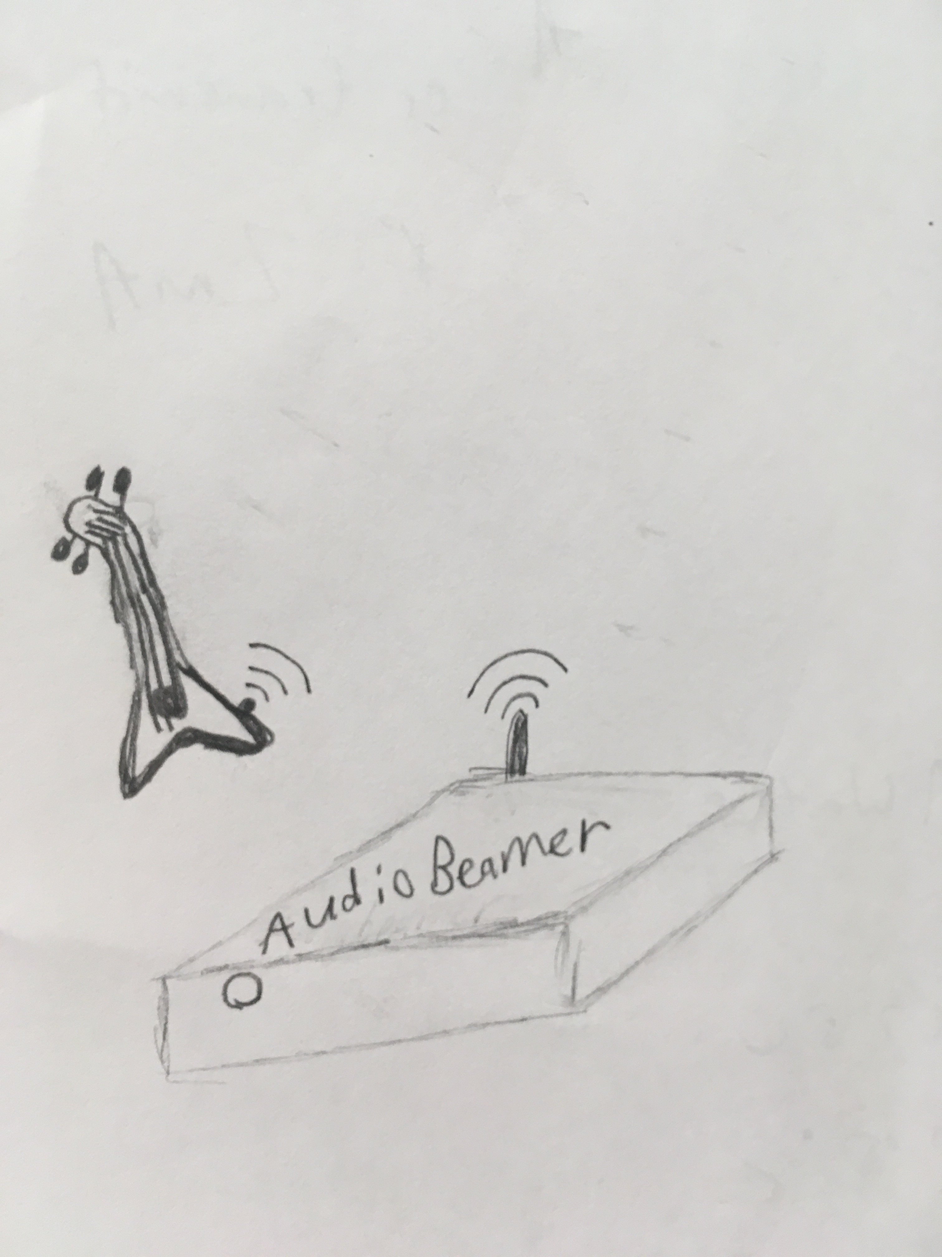
Project Overview
AudioBeamer
Our project aims to simplify the process of applying audio effects to a guitar. It takes in the analog input from the guitar and uses digital signal processing to equalize audio output based on parameters from an Android App. Many products available in the market can transmit the guitar sound but lack the ability to add effects to the audio.
Artistic Rendering
Notes:
CARSON

Slide 4
PSSCs
The ability to interface with an external Audio Codec using I2S that delivers digital data sampled at a 16-bit resolution from an electric guitar and outputs analog audio.
The ability to use Bluetooth data received from an Android cell phone to control audio equalization on the Receiver PCB using UART.
The ability to apply audio effects & equalization such as bass, middle, treble, distortion, and reverb on digitally sampled audio using Digital Signal Processing.
The ability to use a developed Android app to pass user-customizable audio equalization data to the receiver MCU using inbuilt cell phone Bluetooth.
The ability to power the system using an external battery while being able to measure remaining battery levels using a coulomb meter and displaying it using an LED based UI.
Notes:
SKIM OVER

Slide 5
Major Components
MCU – Texas Instruments – MSP430FR5994
Audio Codec – PCM3002
Power management integrated circuit(PMIC) – STC3100IST
Linear Regulator – AP2127K-3.3TRG1
Lithium-ion Battery Charge Management Chip – MCP73837T-FCI/UN
Bluetooth Module – RN4020-V/RM
Audio Amplifier – LM4865
Total Current draw: 40 mA
Amplifier may add up to 100 mA

Slide 6
Major Components
MCU – MSP430FR5994
We will use this to set up and communicate with peripheral devices and for DSP functions/operations
This has a Low-Energy Accelerator for Digital Signal Processing
Specifications
16 MHz max system clock
Supply voltage 3.3 Volt
Recommended 1.8 - 3.6 Volts
Typical current consumption 120 µA/MHz
Max of 1.92 mA
68 I/O
Notes:
CARSON

Slide 7
Major component
Li-ion cell
Planning to use 2000mAh Li-ion cell
Expected battery life = 2Ah / 0.14A = 14.2 hours (Theoretical)

Slide 8
Major Components
Power management integrated circuit – STC3100IST
Can monitor voltage, temperature, current of a single-cell Lithium-Ion battery
We will use this to measure battery capacity to present to the user via an LED interface through the MCU
Specifications
32 kHz clock
Also has a I2C clock line
Supply voltage 3.3 Volts
Recommended 2.7 - 5.5 Volts
Max current consumption 100 µA (typical not given)
1 general purpose I/O
Notes:
CALVIN

Slide 9
Major Components
Bluetooth Module – RN4020-V/RM
A chip that supports Bluetooth Low Energy under Bluetooth specification version 4.1
We will use this component to get equalization, distortion, and reverb values from our Android app and send them to the MCU
Operating on UART with baud rate of 115,200 bits per second
Specifications
Supply voltage 3.3 Volts
Recommended 1.8 - 3.6 Volts
Typical current consumption 16 mA
7 I/O
3 analog, 4 PWM
Notes:
CALVIN

Slide 10
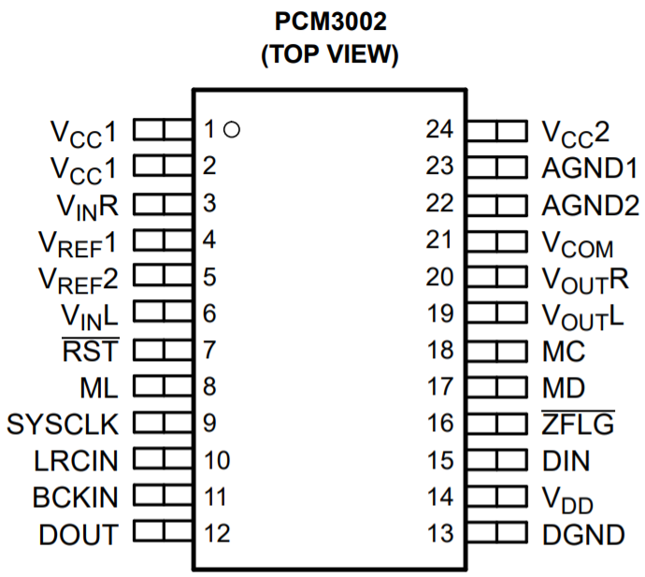
Major Components
Audio Codec – PCM3002
Single-chip stereo audio codec with ADC and DAC lines
We will use this to input audio signals from an electric guitar to our MCU
Specifications
48 kHz max sampling rate clock
Using 44.1 kHz
16/20 Bit Input/output Data
Supply voltage 3.3 Volts
Recommended 2.7 - 3.6 Volts
Typical current consumption 18 mA
Max is 24 mA
"16/20-BIT SINGLE-ENDED ANALOG INPUT/OUTPUT STEREO AUDIO CODECS," October 2000. Online. Available: http://www.ti.com/lit/ds/symlink/pcm3002.pdf [March 2, 2020]
Notes:
SOFTWARE INTERFACING – ADITYA T
3 wire SPI to program the mode control
Left justified I2S
Attenuation
Anti-aliasing
Mute

Slide 11
Major Components
Linear Regulator – AP2127K-3.3TRG1
Capable of regulating voltage down to 0.8V to 5.5V
We will use this to guarantee a relatively constant voltage
Specifications
Supply voltage 3.3 Volts
Recommended 2.5 - 6 Volts
Typical current consumption 60 µA
θ_{ja} = 250 °C/W:
Maximum delta T = θ_{ja}*(4.2V-3.3V) * (140 mA) = 33.75 °C => 58.75 °C @ max battery
39 °C @ nominal battery (3.7V)
Low Dropout voltage – 170mV, will work for entire range of battery
Notes:
ADITYA T

Slide 12
Major Components
LI-ion Battery Charge Management Chip – MCP73837T-FCI/UN
Linear Lithium-Ion/Lithium-Polymer battery charger
Specifications
Supply voltage 3.3 Volts
Recommended 0.3 - 6 Volts
Typical current consumption 1900 µA when charging, 110 µA when charge complete, 75 µA on standby
Max current (IC consumption) 3000 µA, 300 µA, and 100 µA respectively
Auto cutoff
Charge current of cell set at 0.1A (total 3000uA + 0.1A)
θ_{ja} = 113 °C/W
Maximum delta T = θ_{ja}*(5V-3.2V) * (0.1A) = 20.34 °C
Notes:
ADITYA T

Slide 13
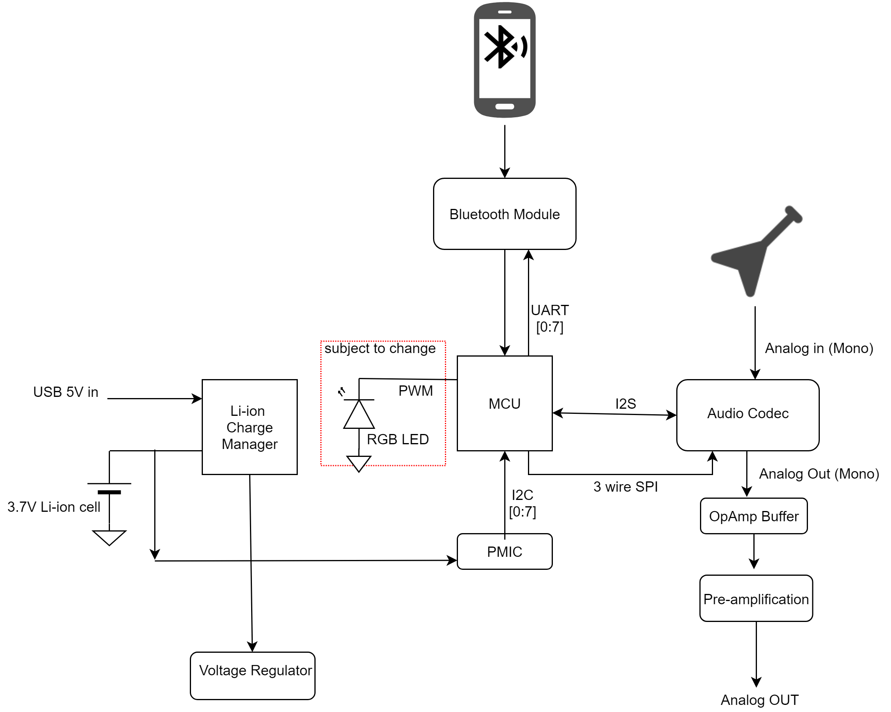
Block Diagram
Notes:
ADITYA T

Slide 14
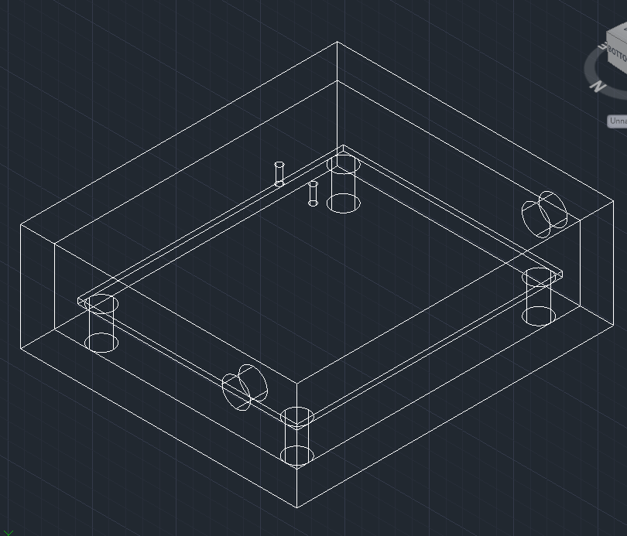
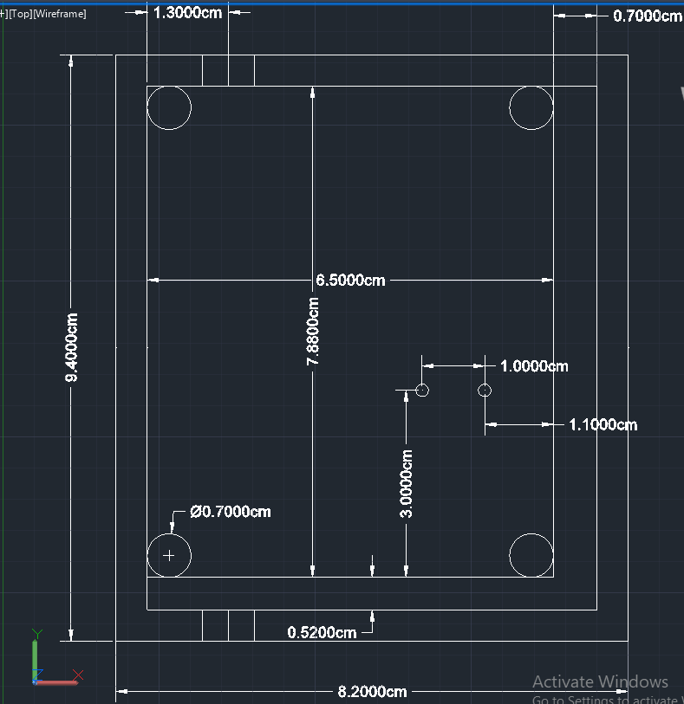
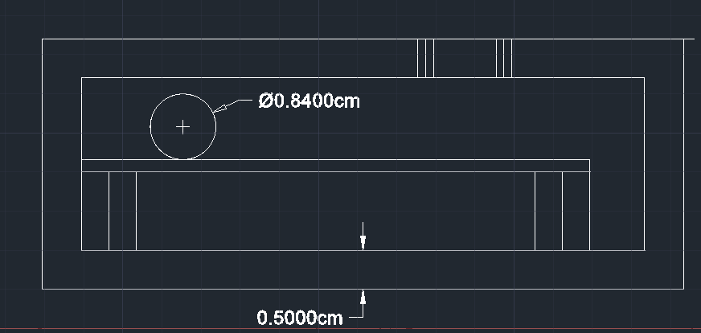
Packaging Design
Notes:
CARSON

Slide 15
Electrical Schematic
MCU footprint too large to be shown on screen clearly
Notes:
ADITYA B

Slide 16
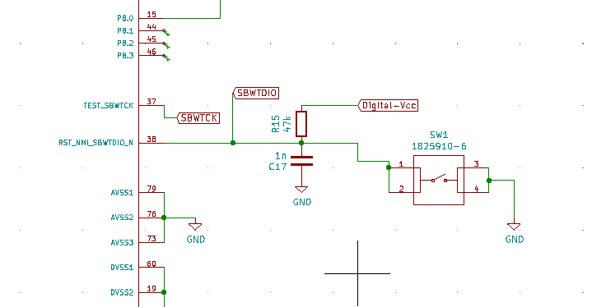
ELECTRICAL SCHEMATIC
Reset CIRCUIT
Followed the recommended circuit

Slide 17
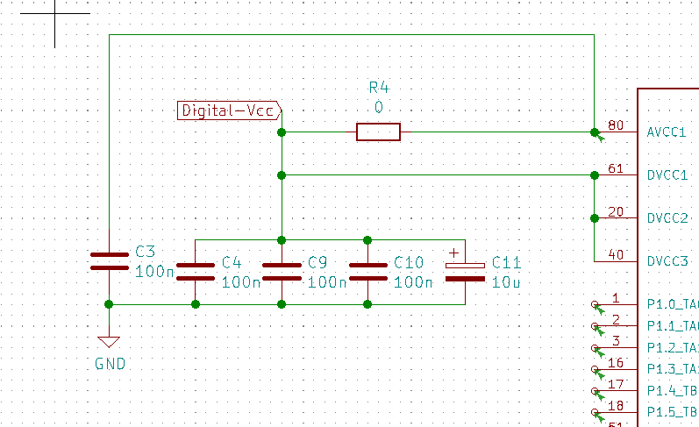
ELECTRICAL SCHEMATIC
BYPASS CAPACITORS ON MCU

Slide 18
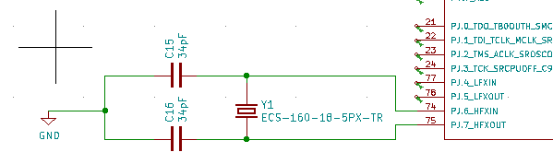
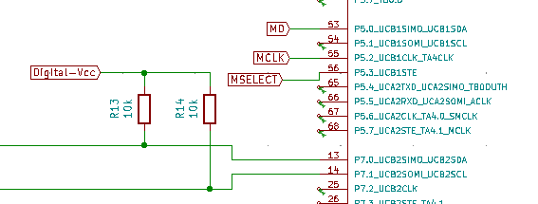
ELECTRICAL SCHEMATIC
EXTERNAL CRYSTAL – 16Mhz 18pF load capacitance
C = 2 * load capacitance – pin capacitance
C = 2 * 18pF – 2pF = 34pF
Pull up resistors for IO lines

Slide 19
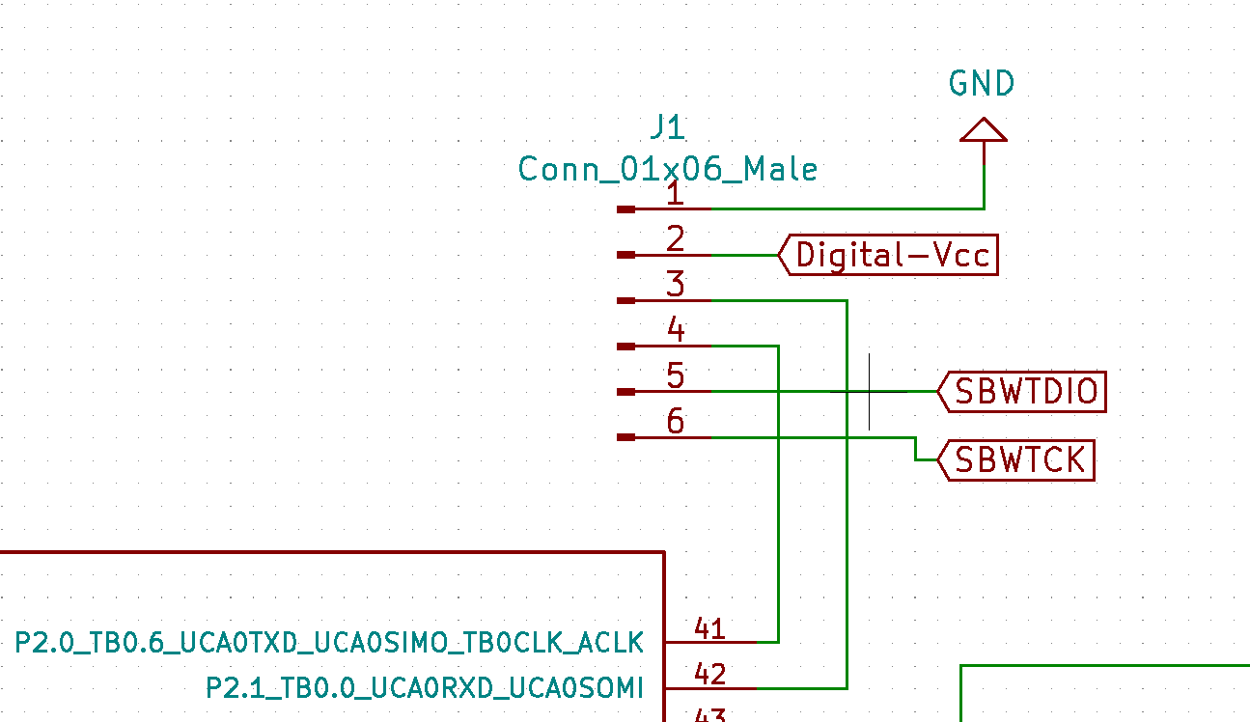
Electric schematic
Bootloader pins
Uses a UART based interface with
the dev-board

Slide 20
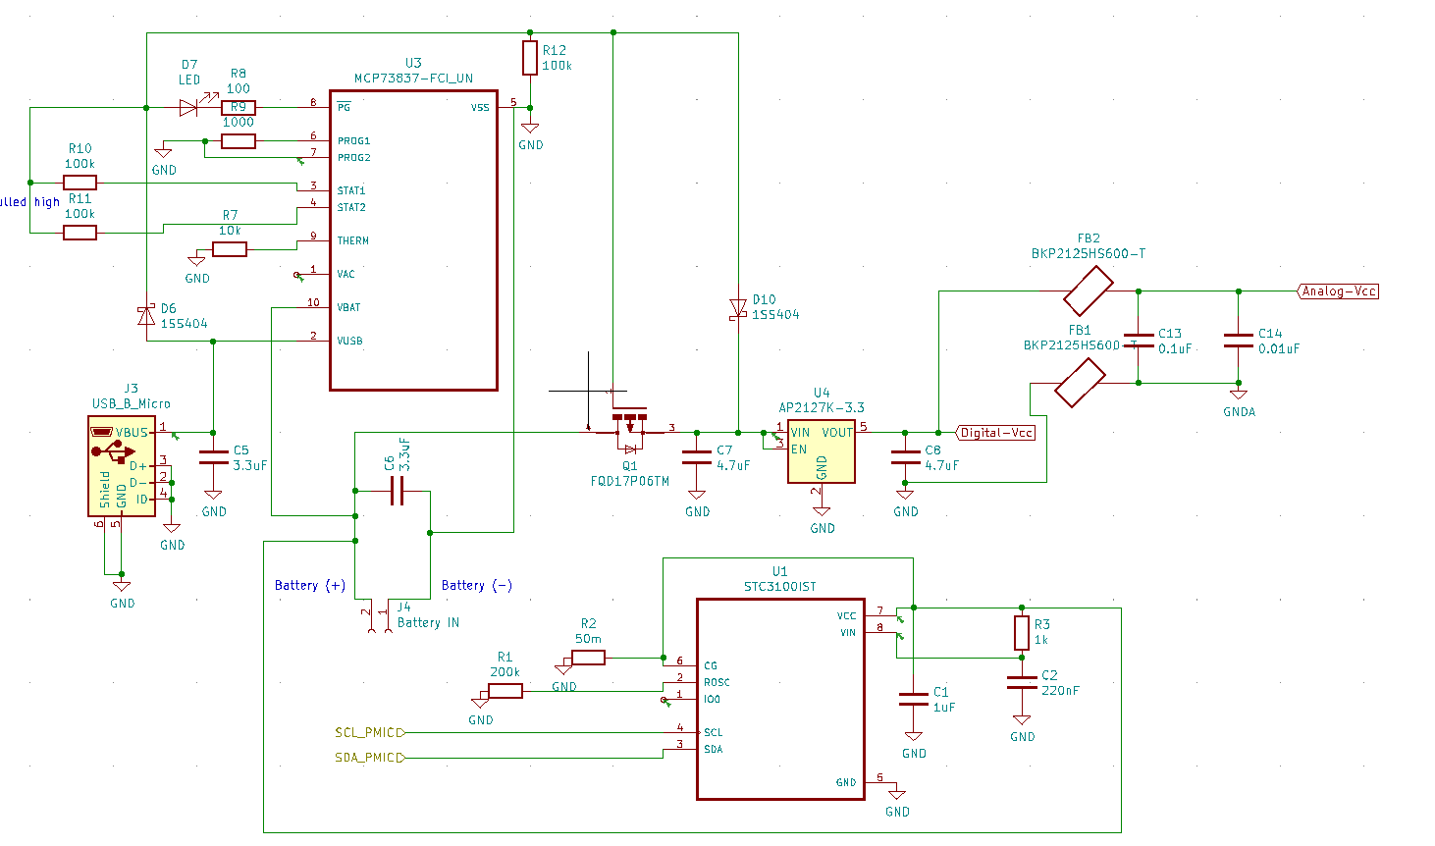
Electric schematic – power system
Power system, battery charger, coulomb counter
Followed recommended circuit and joined them together

Slide 21
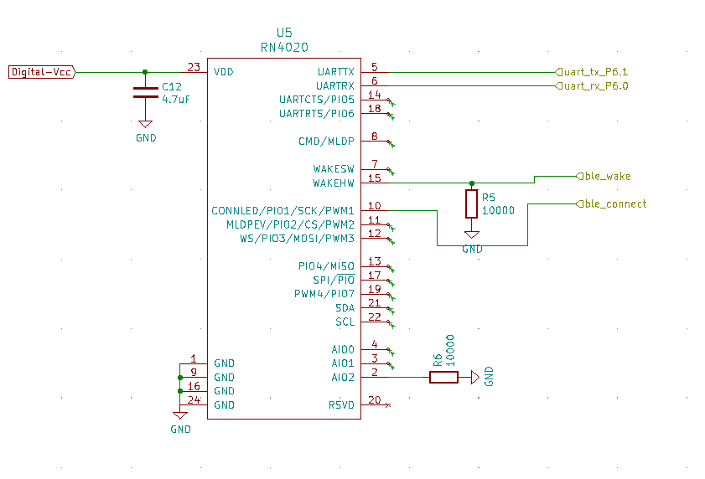
Electric schematic
Bluetooth circuit – rn4020
Followed recommended circuit

Slide 22
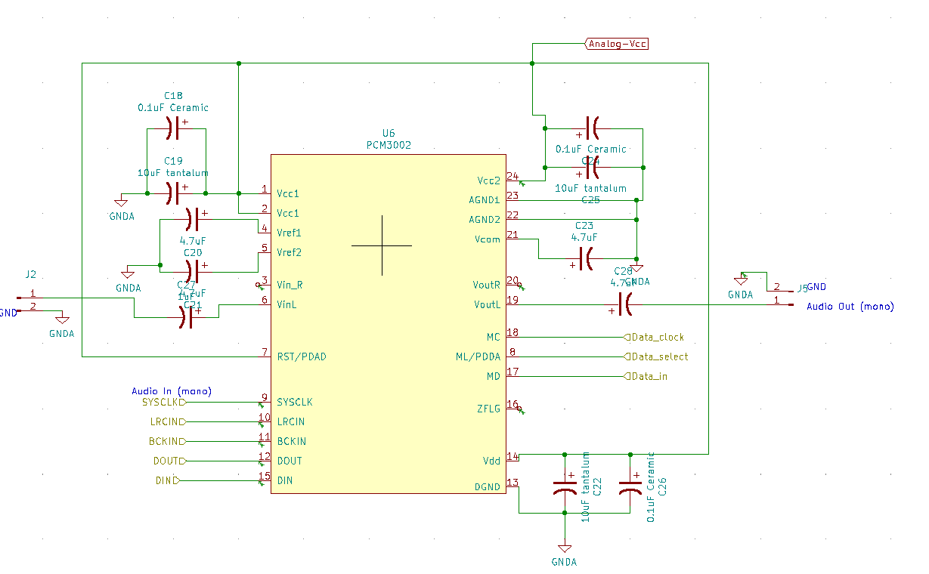
Electric schematic
Audio codec
Followed recommended circuit

Slide 23
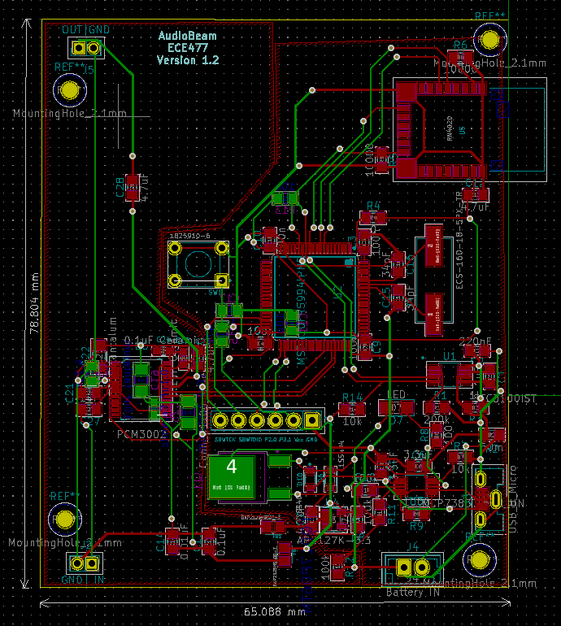
PCB Layout
Overall layout
Notes:
ADITYA B

Slide 24
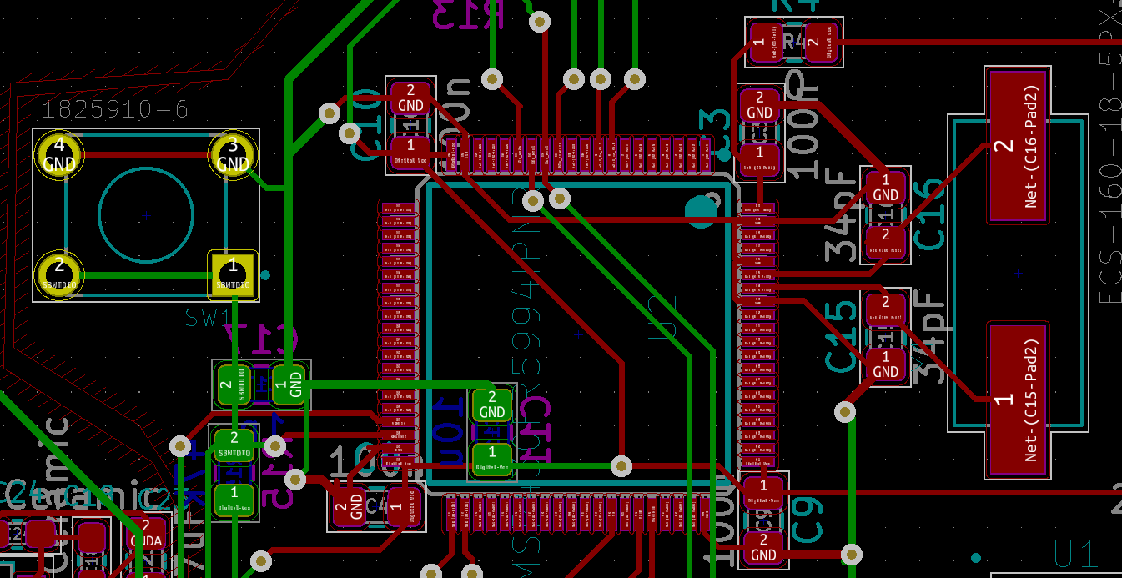
PCB LAYOUT
MCU BYPASS CAPACITORS , RESET SWITCH & CRYSTAL

Slide 25
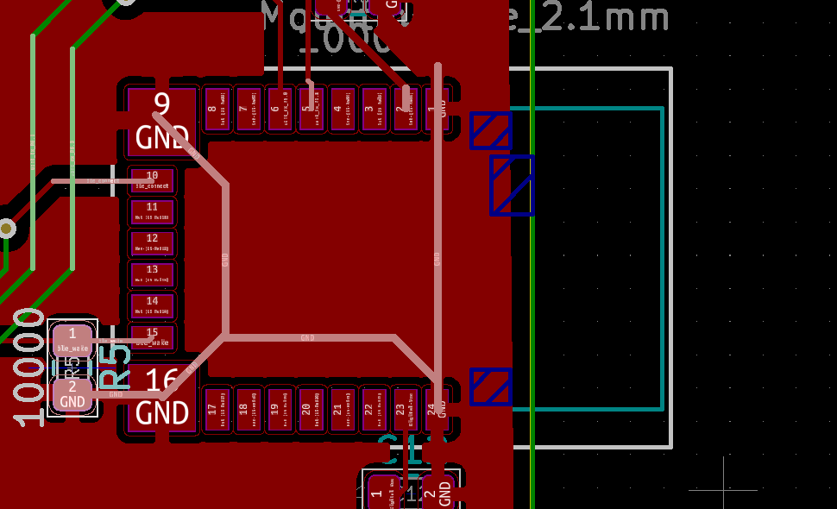
PCB LAYOUT
ground plane shielding

Slide 26
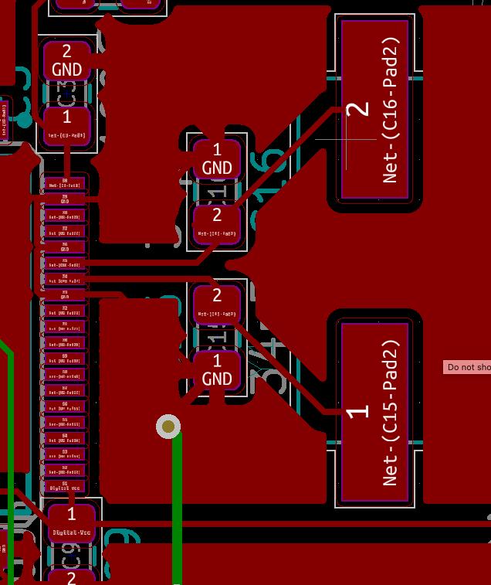
PCB LAYOUT
crystal
CRYSTAL GROUND PLANE

Slide 27
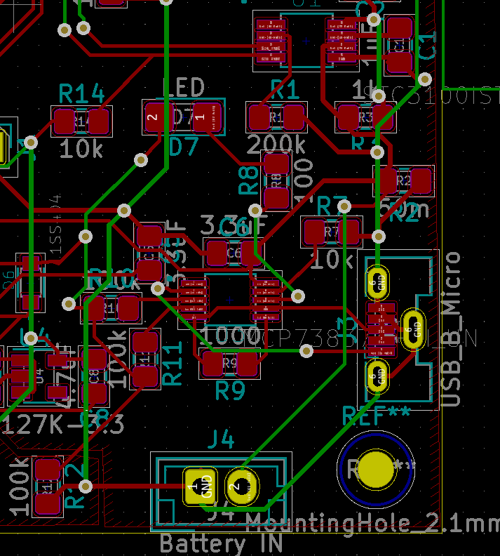
PCB LAYOUT
POWER SYSTEM
Single LED for charge status
indication

Slide 28
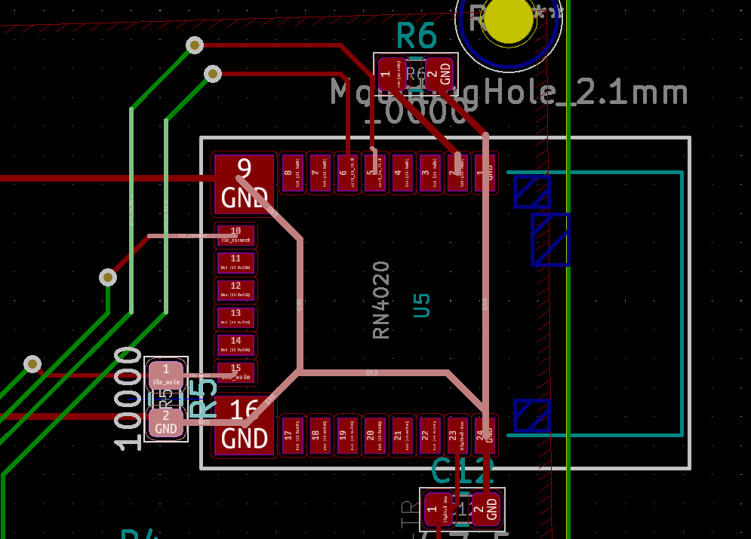
Pcb layout
Bluetooth module

Slide 29
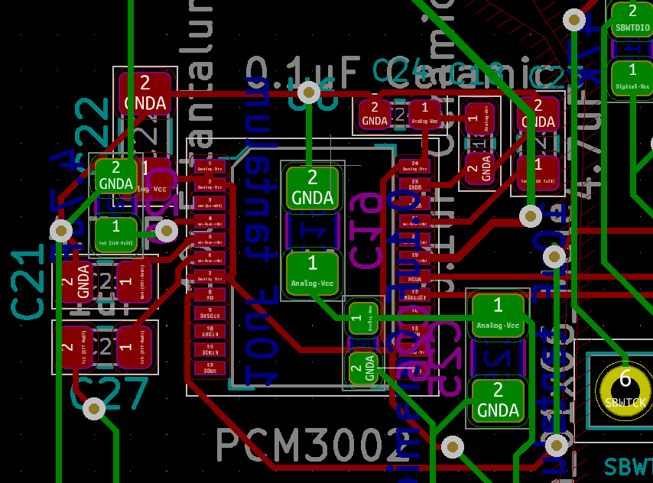
Pcb layout
Audio systems - PCM3002 AUDIO CODEC
Lots of capacitors!

Slide 30
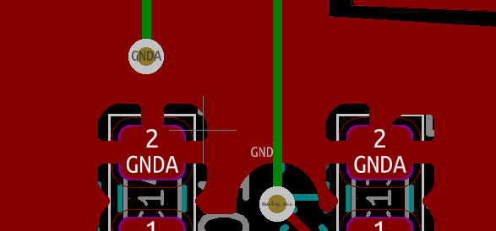
PCB LAYOUT
Audio systems
Using separate ground plane

Slide 31
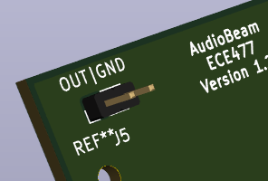
PCB LAYOUT
AUDIO SYSTEMS
Amplification circuit not designed yet
Should be implemented in a few days
Will manually solder wire to female ¼ audio jack
Mainly to avoid mounting jack on PCB

Slide 32
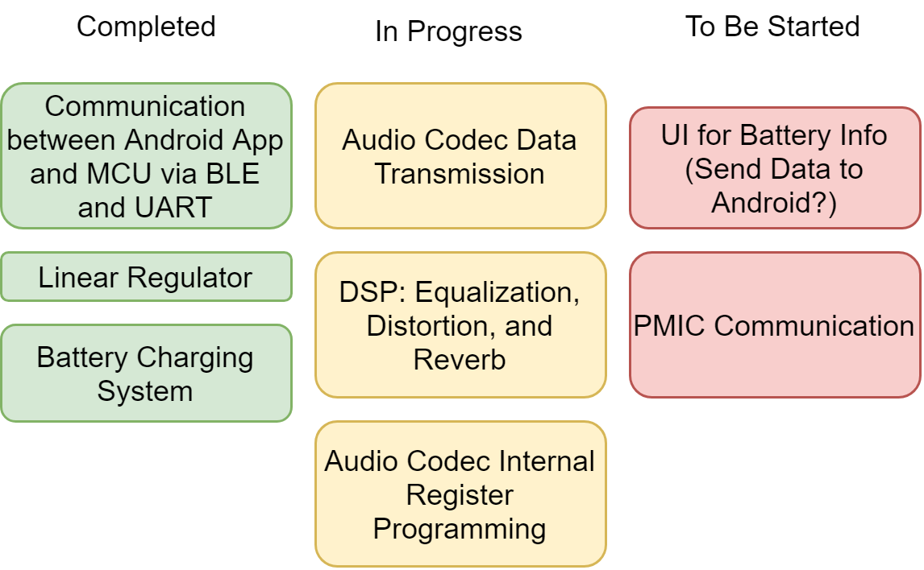
Prototyping Progress

Slide 33
PROTOTYPING PROGRESS
MCU – MSP430FR5594
PARTIALLY COMPLETE
Test ability to set up and communicate with the Bluetooth module via UART (complete)
Test ability to set up and communicate with the audio codec via … (partially complete)
Test ability to set up and communicate with the PMIC via I2C and flash an LED accordingly (not started)
Test ability to apply equalization, distortion, and reverb effects to audio signals (barely started)

Slide 34
PROTOTYPING PROGRESS
Audio Codec – PCM3002
PARTIALLY COMPLETE
Test ability to receive an audio signal from an electric guitar (not started)
Test ability to communicate with the MCU via … (partially complete)
Receive I2S output from a provided waveform (complete)
Still working on system & data clock synchronization
Amplification design & testing (not started)

Slide 35
PROTOTYPING PROGRESS
Power management integrated circuit – STC3100IST
NOT STARTED
Test ability to be set up by and communicate with our MCU via I2C (not started)
Test ability to receive accurate voltage values from our battery (not started)

Slide 36
PROTOTYPING PROGRESS
Bluetooth Module – RN4020-V/RM
FULLY COMPLETED
Test ability to communicate with Android APP via low energy Bluetooth (works)
Test ability to disconnect and unbind from previous devices (works)
Test ability to connect and bind to the Android app (works)
Test ability to receive data from the Android app to distinguish sliders from each other and the value sent (works)
Test ability to send data via UART to the MCU (works)
Test ability to be properly set up via UART by the MCU (works)

Slide 37
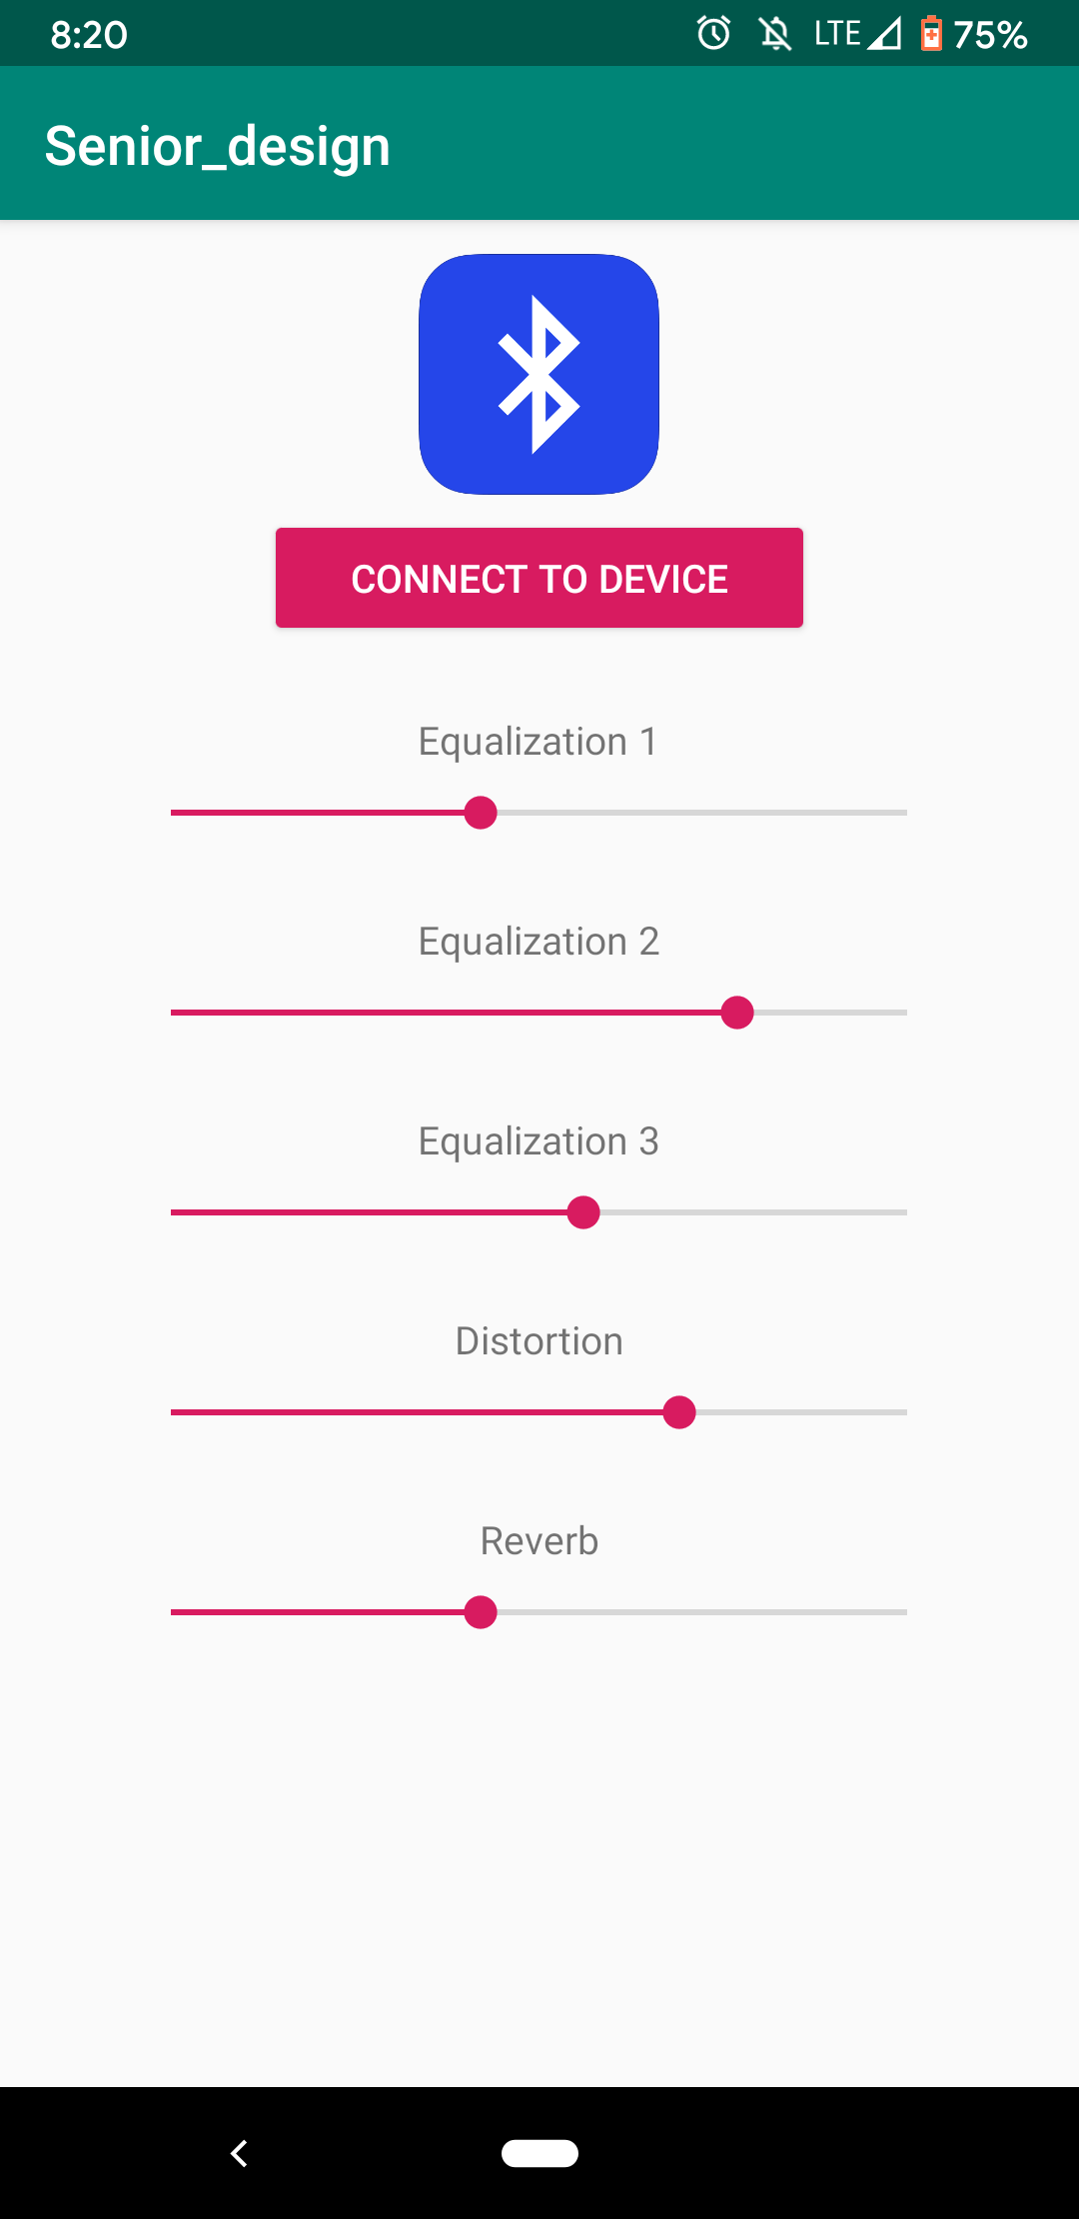
PROTOTYPING PROGRESS
Android App
BASICALLY COMPLETED
Test ability to communicate with Bluetooth module via low energy Bluetooth (works)
Test ability to connect and bind to the Bluetooth module indefinitely (works)
Test ability to send an integer value based on a slider for multiple sliders (works)
All further work done on this component will be UI improvements; all functionality is completed
Notes:
CALVIN

Slide 38
PROTOTYPING PROGRESS
POWER SYSTEM AND CHARGING CIRCUIT
ALMOST COMPLETED
Test ability to provide stable 3.3V DC to our system at up to 300mA (Complete)
Test ability to use a Li-ion cell to power the system reliably (Works in lab)
Test ability to charge Li-ion cell while providing power to our system (Complete)
Test analog ground separation circuit (ongoing)

Slide 39
Software Development Status
Status by software category
Interfacing
Bluetooth Low Energy (UART) - Completed
Audio Codec – In development
PMIC (I2C) - Not yet started
Android App
Bluetooth Low Energy – Completed
User Interface – Mostly Completed
Digital Signal Processing
Equalization – In early development
Reverb – In early development
Distortion – In early development

Slide 40
Software Development Status
Third party software
Android Application
Android.bluetooth
Used to communicate to RN4020 (Bluetooth module)
Utilizes Bluetooth Low Energy
Android.widget
Used to create GUI
Includes text, sliders, and buttons
MCU (MSP430)
MSP DSP library
Computations for equalization
Computations for reverb
Computations for distortion

Slide 41
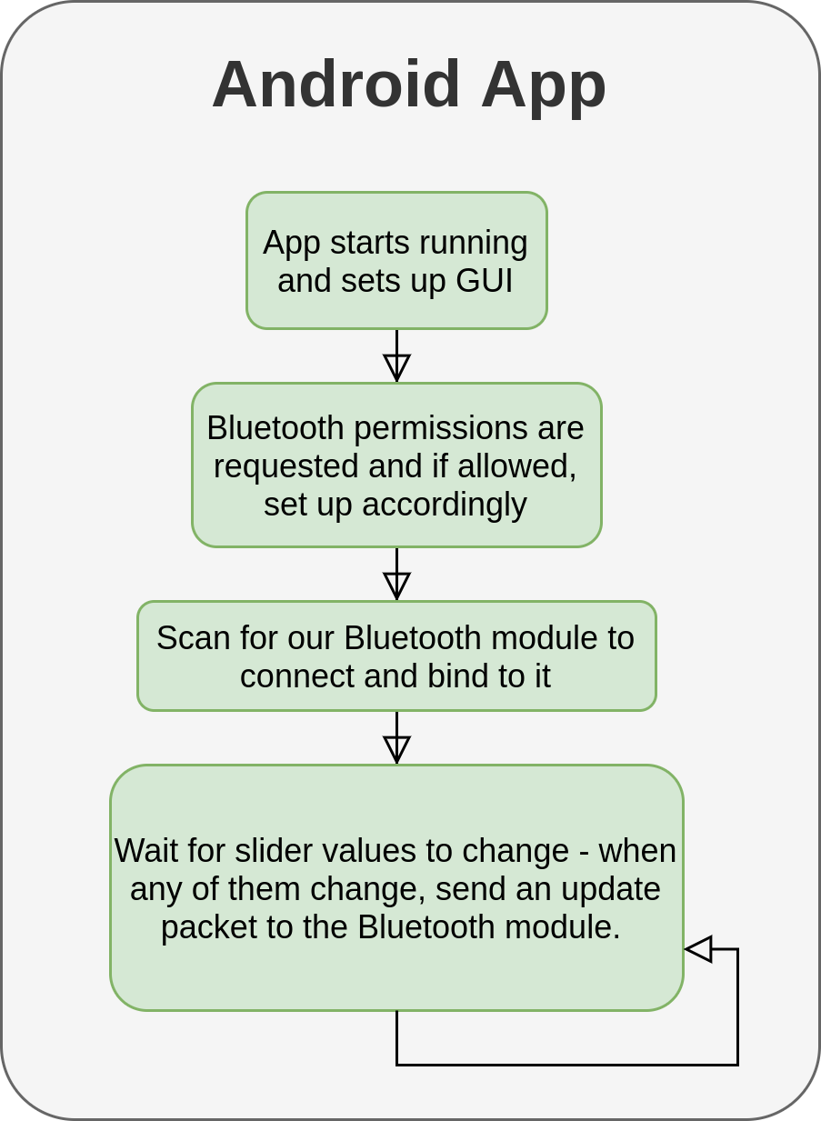
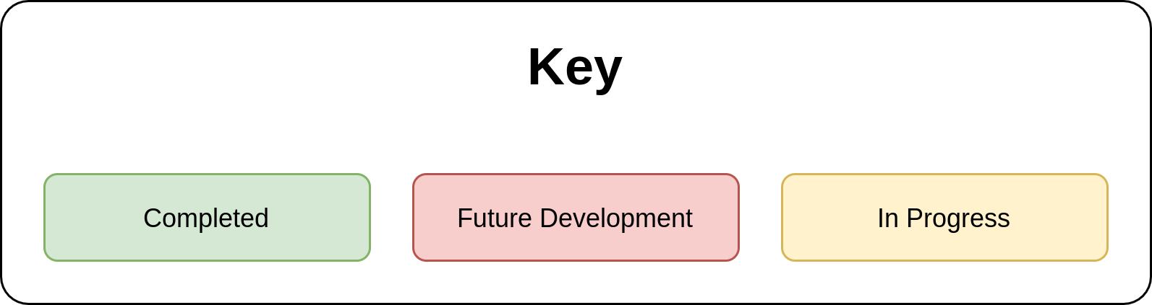

Slide 42
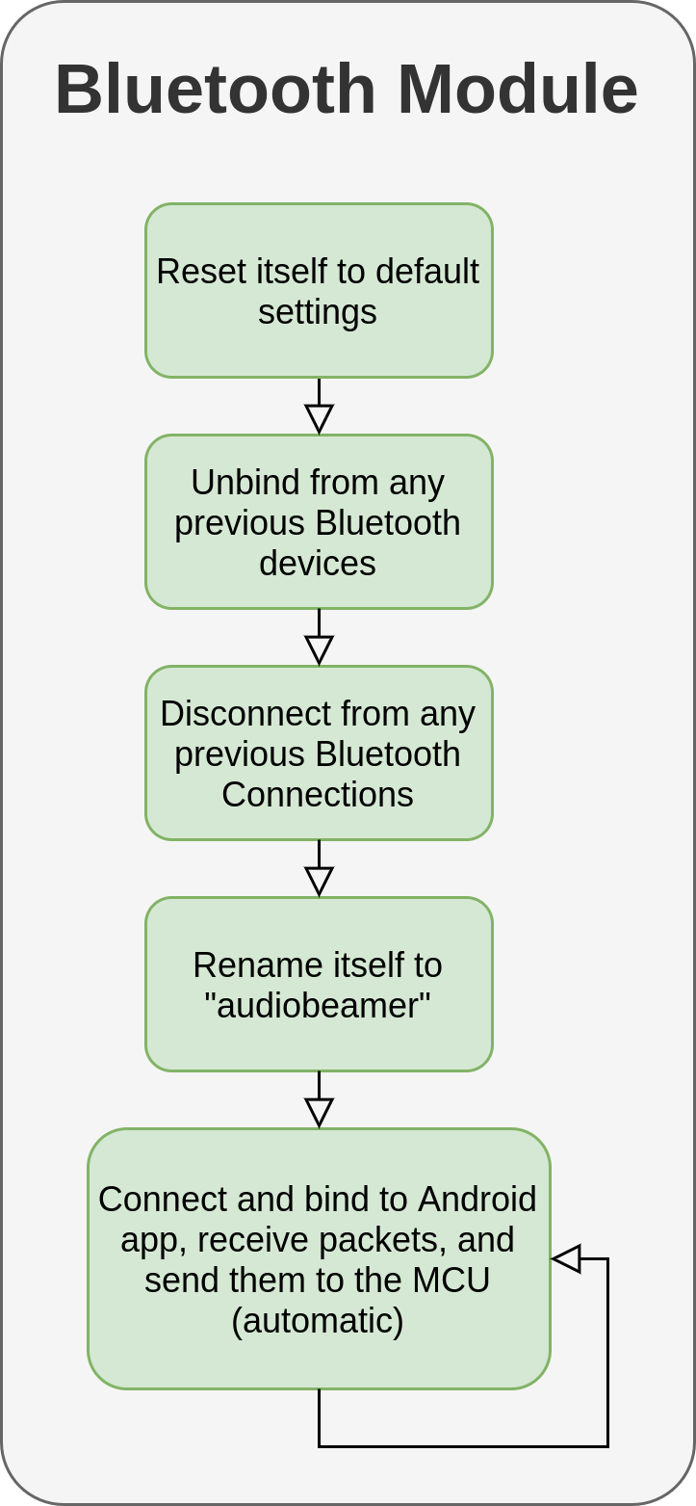

Slide 43
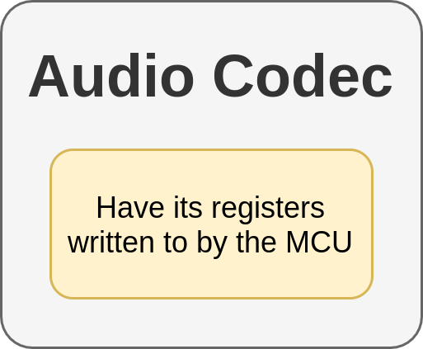

Slide 44
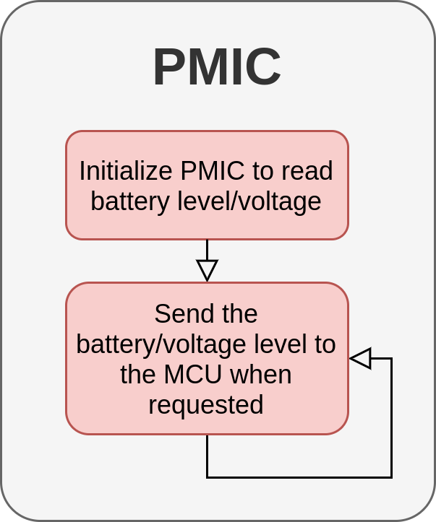

Slide 45
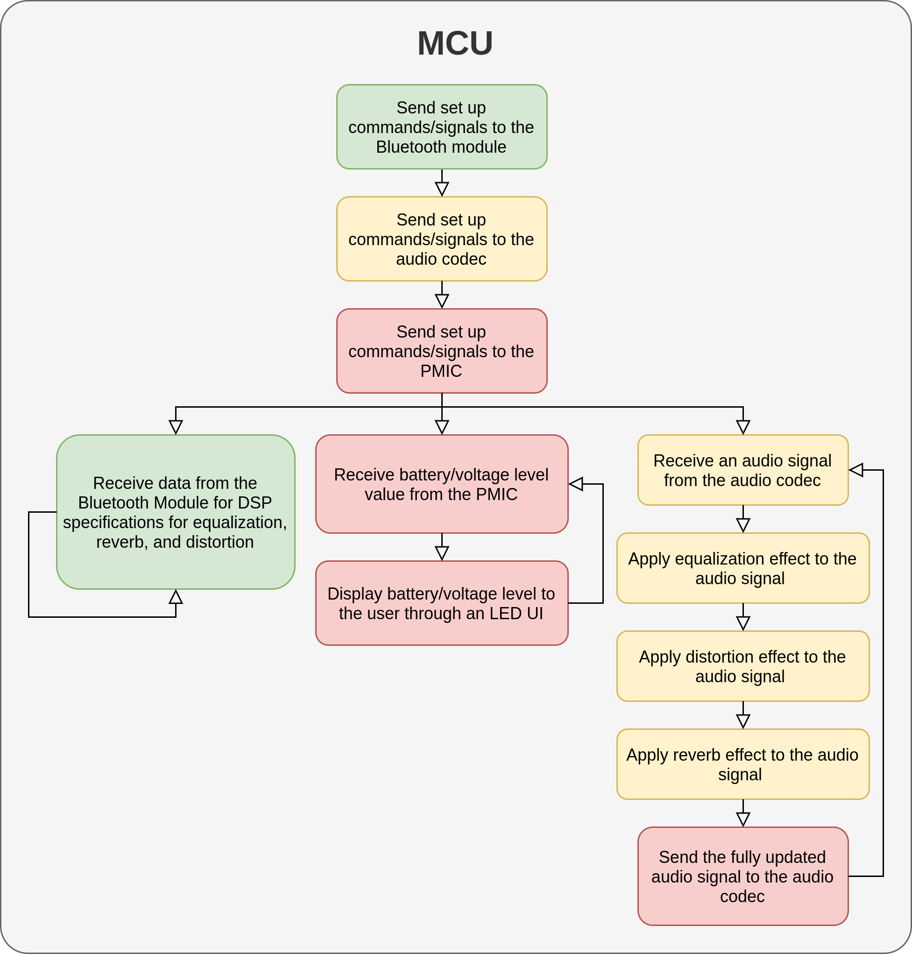

Slide 46
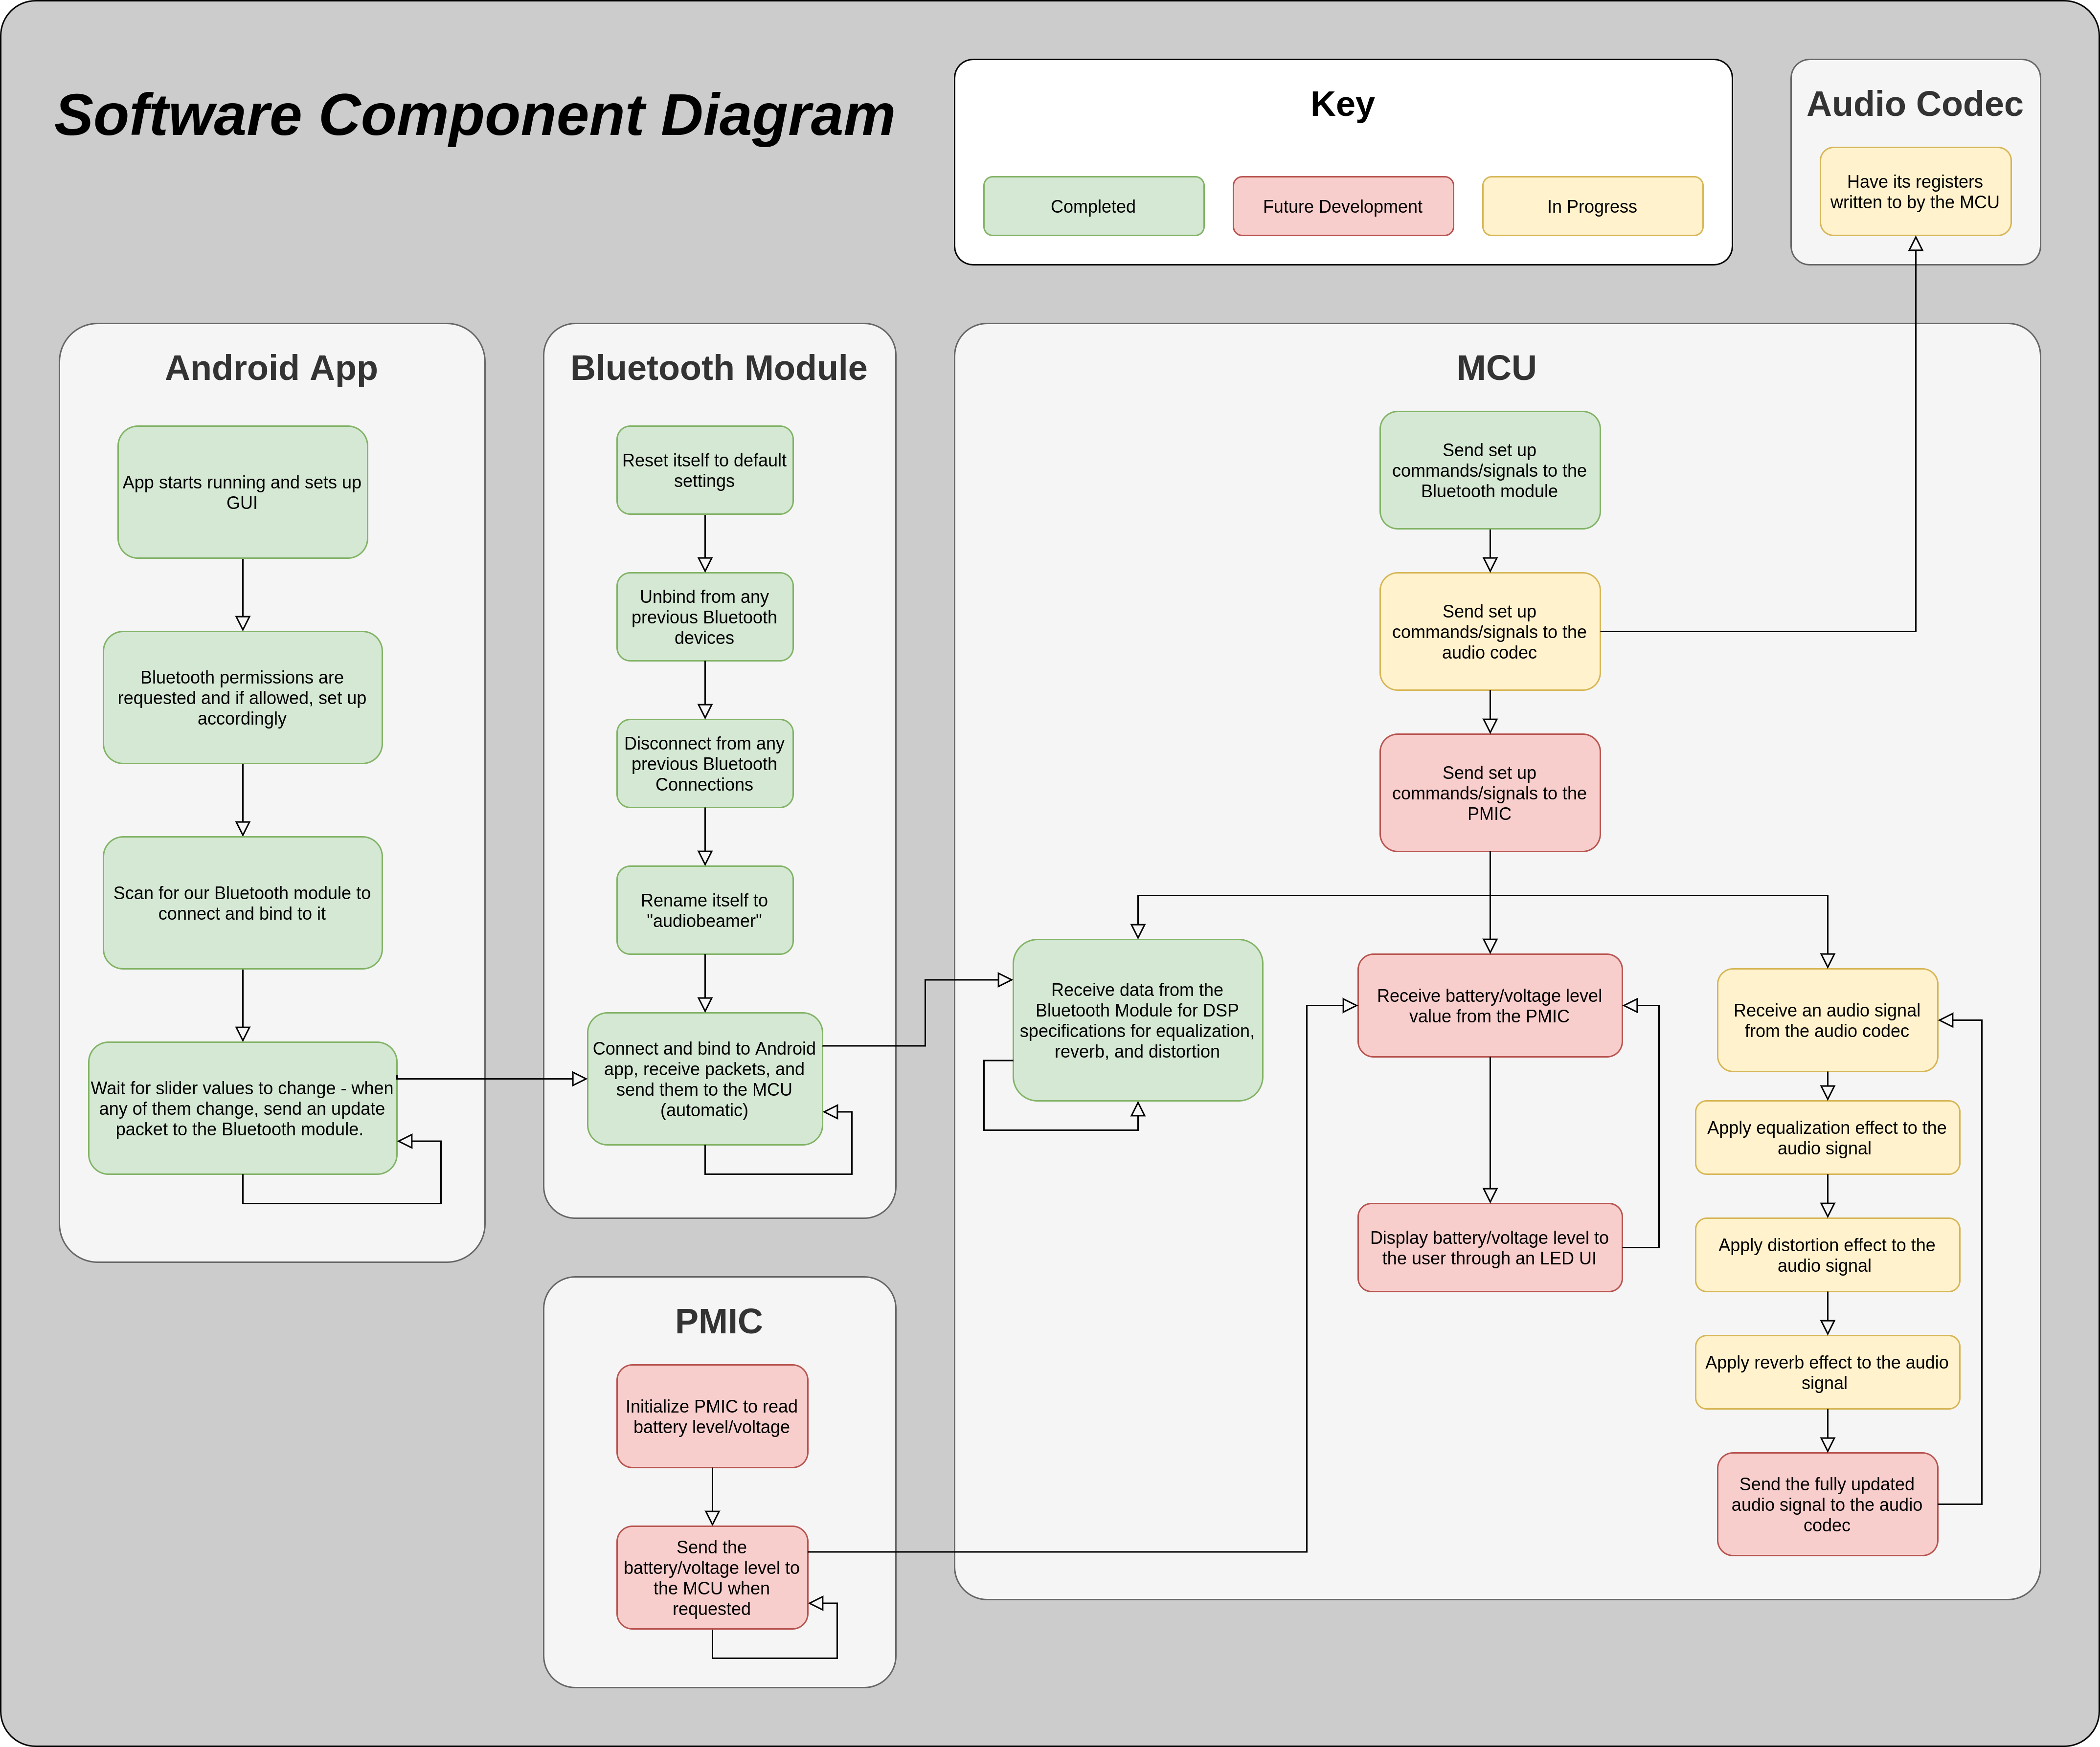

Slide 47
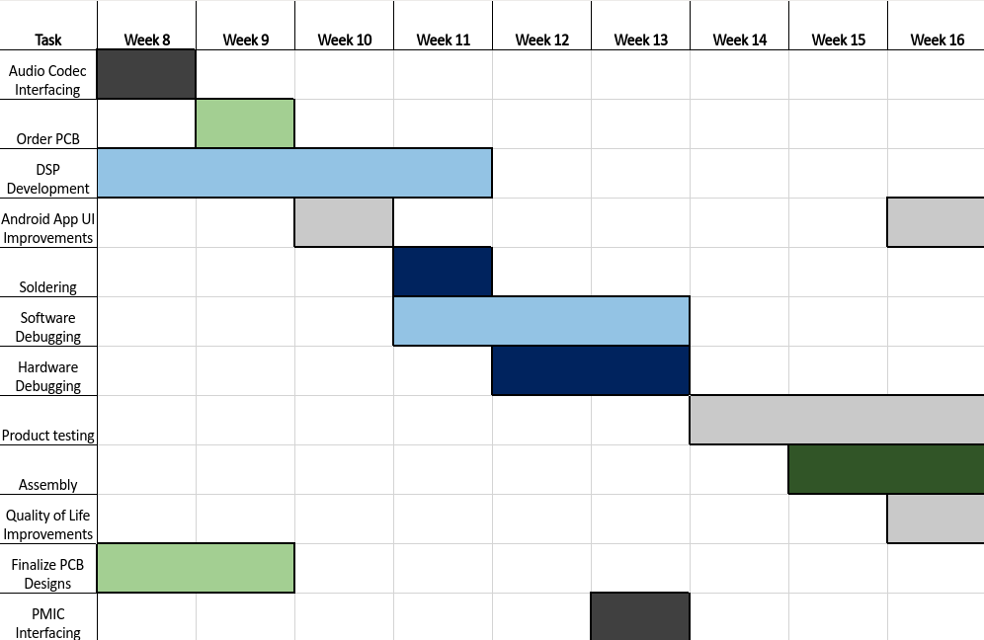
Project Timeline

Slide 48
3D Printing
Questions?

